Slide 1
A DATELINE SPECIAL INVESTIGATION
THE RYALS FAMILY FILES
The Case of the Missing Margin
Unmasking the leaks, tracking the suspects, and the house we build when the case is closed.
Notes:
(Keith Morrison Voice... Slow, rhythmic, pregnant with suspense)
It was a house like any other house. On a street like any other street. From the outside, it looked... perfect. Two loving parents. Two beautiful girls. A healthy six-figure income flowing into the bank accounts. But beneath the surface, in the quiet spaces of the family ledger, something... was slipping away. A margin... missing. Vanished into thin air.
Welcome to a Dateline Special Investigation. Tonight, we unmask the leaks. We track down the silent priority suspects. And we show the incredible, locked-in blueprints of the house they are going to build at the end... once this case is closed.

Slide 2
ACT 1: THE ALIBI
Before we trace the leaks, let's examine our assets. Strength is our alibi.
THE ASSET PROFILE
Combined Income
$275,000 / year
Net Worth
~$308,000
Home Equity
$218,000 (est.)
RETIREMENT SECURITY
Brent Schwab 401k
$56,085
Dani Employer 401k
~$100,000
Employer Matching
SACRED & UNTOUCHED
THE SILENT WITNESS
Verizon Pension
$104,744
Vested Present Value
(Vested during 10-yr service)
The Option:
Normal retirement (available 3/31/2046) provides $710.44/mo single life or $104k lump sum.
Notes:
(Keith Morrison Voice... Slowly building interest)
To solve any mystery, you have to look at the suspects' alibis first. And theirs? It was surprisingly... solid. Some might even call it a fortress.
A heavy household income of two hundred and seventy-five thousand dollars. A positive net worth of over three hundred thousand dollars. Over two hundred thousand dollars in home equity right here on Garden Lane. Two robust, active retirement profiles... and then... a sudden twist. A secret hidden in the vault. A forgotten Verizon pension. One hundred and four thousand, seven hundred and forty-four dollars. Fully vested. Sitting there, in the quiet shadows, growing. They weren't bankrupt. They weren't in a hole. They were organizing their strength.

Slide 3
THE THREAT: THE $102k DEBT RANSOM
The hurdle standing between our family strength and the home we build at the end.
THE COMBINED LIABILITIES
The Total Ransom: ~$102,000
• 0% Promotional Credit Cards: ~$38k (The immediate target)
• Texas Trust CC (13.90%): $23,920.94
• Discover Loan (10.99%): $23,771.50
• LightStream Loan (11.99%): $16,441.41
THE ACTIVE COUNTER-STRIKE
It Already Started!
This isn't a plan we are going to start 'someday'. The opening strike occurred before this meeting.
July 31 Commission Payment
A massive chunk was sent directly to Priority 1: Brent's Discover card, knocking it down hard before its October deadline.
Notes:
(Keith Morrison Voice... Lowering pitch, serious and slow)
But every story has its villain. A dark figure in the ledger. And here? It was a combined debt of one hundred and two thousand dollars. Revolving cards... personal loans... holding their future hostage. Standing directly between them and that dream addition. No drama. No blame. Just a cold, hard number.
But they weren't waiting. Oh, no. Before the slides were even shown... before the discussion began... the first counter-strike had already been fired. July thirty-first. Commission day. A large, lethal payment sent directly to Brent's Discover card. They weren't planning a defense. The hunt... had already begun.

Slide 4
SUSPECT LINEUP: THE 0% CARD COUNTDOWN
An isolated, highly structured mission. Every 0% balance systematically zeroed by January 2028.
STAGE ONE: THE IMMEDIATE EXPIRATIONS
Brent Discover (Expires Oct 2, 2026)
Paid down hard until expiration. Remaining balance rolled safely to a new 12-month 0% transfer card.
Dani BOA (Expires Nov 12, 2026)
Paid down hard until expiration. Remaining balance rolled safely to second 12-month 0% transfer card.
STAGE TWO: THE SYSTEMATIC TAKEDOWN
• Dani Discover — Promo expires May 2, 2027
• Brent Double Cash — Promo expires Jul 1, 2027
• Dani Wells Fargo — Promo expires Aug 1, 2027
• The Two Transfer Cards — Expiring Oct & Nov 2027
• Chase Slate Finale — Promo expires Mar 1, 2028
Every promo balance at absolute ZERO by January 2028. Zero interest paid.
Notes:
(Keith Morrison Voice... Slowly walking the lineup)
Let's look at the lineup. Eight individual promotional credit card balances. A ticking clock. But this isn't a random fight. It's a calculated, two-stage military-grade countdown. Stage one: Brent's Discover and Dani's BOA. They expire first. We squeeze them, then deploy a tactical transfer—buying twelve more months of interest-free air. Stage two: Starting December, we line them up one by one. May. July. August. October. November. And then... the January twenty-eight finale. Chase Slate. Dead. Gone. Every single one of them at zero. Interest paid? None.

Slide 5
THE PAPER TRAIL: TRANSFERS AS A CHEAT CODE
Understanding the math behind our defensive balance transfer operations.
THE ACTIVE SILENT THIEF
Interest Paid Now: ~$399 / mo
This isn't a theoretical argument. We are actively paying almost $400 every single month in purchase interest—primarily on the Texas Trust balance at 13.90%.
If a 0% promotional card rolls to standard interest (~20%+), every $10,000 carried costs $2,000/year in interest. A bleeding wound we cannot allow.
THE INSIDER SHIELD
The One-Time 5% Toll
Rolling our Stage 1 remaining balances onto fresh 12-month 0% cards incurs a small, one-time 5% transfer fee on ONLY what remains to move.
• No ongoing monthly compound interest
• Every dollar paid down before transfer shrinks the fee
• A microscopic cost to guarantee 0% protection
Notes:
(Keith Morrison Voice... Lean in, intense and intimate)
Let's look at the paper trail. We aren't speculating about what interest charges feel like. We're feeling them. Three hundred and ninety-nine dollars every single month, draining from the ledger on purchase interest. It's happening... right now. Mostly on Texas Trust.
And if our promotional cards roll to standard rates? If we let them expire? That's twenty percent interest. Over two thousand dollars a year for every ten grand carried. But there's an insider shield. A cheat code. The balance transfer. Yes, there is a small, five percent one-time toll. But it stops the compound interest dead. It's the cost... of safety.

Slide 6
INTERROGATING THE SUSPECT: WHAT IS NORMAL?
Let's examine the USDA national spending benchmarks first. Let them tell the story.
USDA & BLS NATIONAL BENCHMARKS
• USDA Thrifty Plan: $900 - $1,100 / mo
• USDA Moderate Plan: $1,200 - $1,500 / mo
• USDA Liberal Plan: $1,600 - $1,900 / mo
Income-Bracket Reference ($200k-$275k):
Average monthly food spend including dining out is $1,800 - $2,200. Financial advisors consider a healthy target at our income to be $1,360 - $1,700/mo.
OUR DELIBERATE COMFORT BUFFER
Our Food Budget: $2,500 / mo
We are deliberately setting our proposed budget ABOVE every single benchmark. Not at it. Above it.
"The liberal plan says $1,900. Our income group averages $2,200. I am asking for $2,500—more than any of them—because I want us to be comfortable. I built this room in on purpose."
Notes:
(Keith Morrison Voice... Slowly developing the mystery)
Let's interrogate the suspect. Food spending. What is normal? The government, they have a number. Thrifty, moderate, liberal plans... topping out at nineteen hundred dollars for a family of four. Other households in their high-income bracket? They average twenty-two hundred.
But look. Brent isn't asking for nineteen hundred. He's not even asking for twenty-two hundred. The ask? Twenty-five hundred. More than every single national benchmark on the table. Why? Because he doesn't want Dani to feel trapped. He built the room in. On purpose.

Slide 7
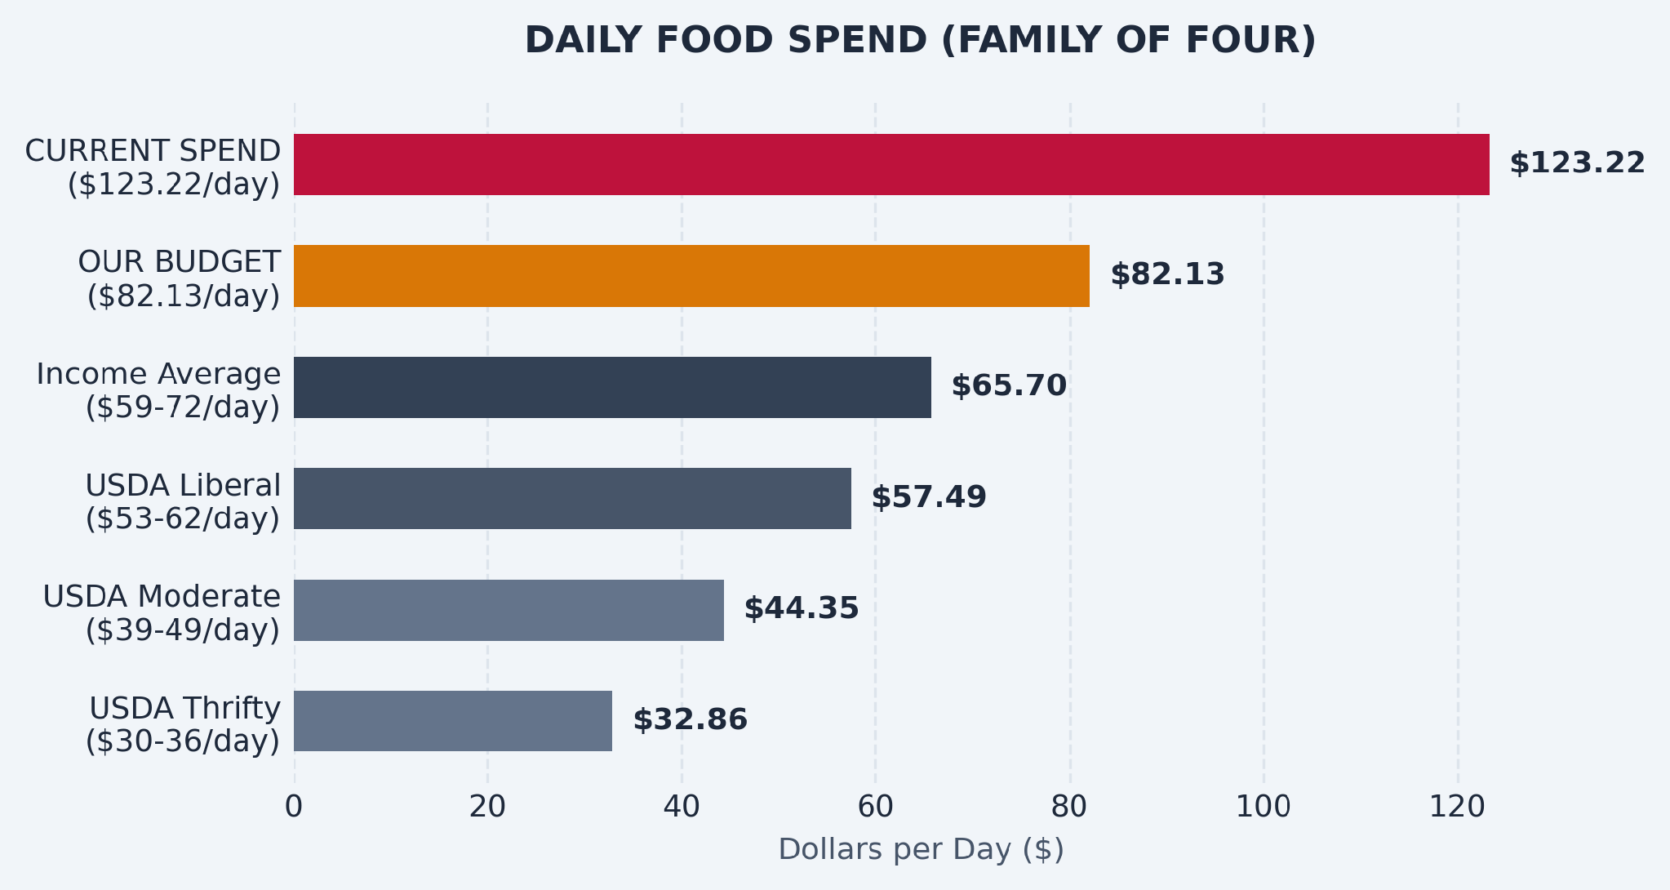
EXHIBIT A: DAILY FOOD SPEND COMPARISON
A month is hard to visualize. A day is simple. $1,251/mo is a sacrifice; $41/day is a decision.
THE ANATOMY OF THE DAILY GAP
The Gap: $41.09 per day
Moving from our massive $123.22/day everyday baseline to our comfortable $82.13/day budget.
Per Person, Per Day Breakdown:
• Current Spend: $30.81 per person/day
• Proposed Budget: $20.53 per person/day
• USDA Moderate Plan: $10.84 per person/day
Even after the budget, we spend double the national moderate average per person.
Notes:
(Keith Morrison Voice... Deep, slow, emphasizing individual numbers)
Let's look at the daily record. Exhibit A. A month... a month is a heavy concept. But a day? A day is a series of simple choices. Twelve hundred and fifty-one dollars a month sounds like an agonizing sacrifice. But forty-one dollars a day? It's just a decision you make at lunch.
Look at the chart. Even after making this decision, their daily food bar—eighty-two dollars a day—towers above the national average. It's twenty dollars and fifty-three cents per person, every single day. Generous. Solid. Yet, that simple forty-one dollar daily gap changes everything.

Slide 8
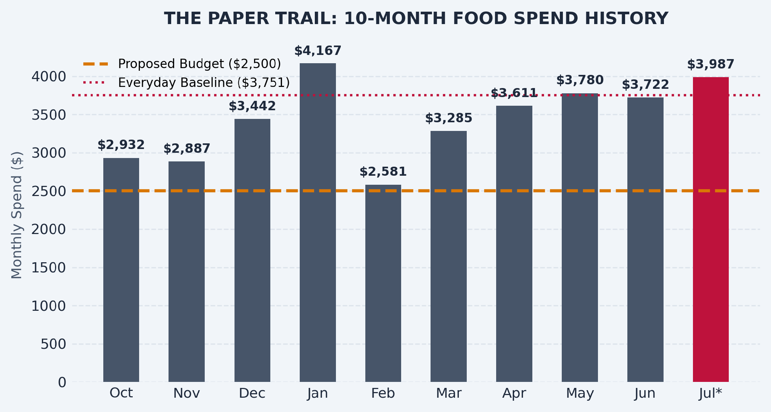
EXHIBIT B: THE 10-MONTH PAPER TRAIL
A detailed ledger of our actual transactions over the last 10 months.
THE BEACH TRIP ALIBI
July Spend: $3,987
• Beach Trip Food Spend: $1,445
• Everyday Food Spend: $2,542
Our vacation is 100% protected. Vacation food has its own separate line item. It is NOT part of the food budget and is NOT being cut.
"The beach is in there. The beach stays."
Notes:
(Keith Morrison Voice... Slowly building interest and drama)
Let's look at the paper trail. Ten months of transactions. A story written in swipes... May and June settled at an everyday baseline of about thirty-seven hundred and fifty-one dollars. And then... July. Almost four thousand. But wait. Look closely. There's an asterisk on July. A beach trip. Shunk Gulley... Goatfeathers... Publix... Papa Surf.
Exactly fourteen hundred and forty-five dollars of that spend was the vacation. And the vacation? It has an airtight alibi. It's protected. It's separate. They are NOT cutting the things that bring them joy. The beach... stays.

Slide 9
THE SOLVED HEIST: WHAT ONE BUDGET UNLOCKS
A single category change provides the primary fuel for our entire debt-freedom strategy.
THE CASH FLOW VELOCITY
$1,251 / month Freed
• Freed up over 18-month countdown: $22,516
• Freed up over a single full year: $15,011
Conservative Check: Measured against our 12-month average ($3,459) instead of recent peak months, we still free $959/month ($17,262 total).
THE CARD COUNTDOWN COOPERATIVE
59% of the Countdown Covered
The entire card countdown requires a monthly pace of $2,108. This ONE budget change covers more than half of it!
Which means we do not have to touch vacations, date nights, kid spending, 401k matching, or our general quality of life. The food budget does the heavy lifting.
Notes:
(Keith Morrison Voice... Slowly building the dramatic tension)
Here is where the heist is solved. One single category. A quiet change that frees up twelve hundred and fifty-one dollars... every... single... month. Twenty-two thousand, five hundred and sixteen dollars over the course of our countdown.
And what does that buy? It covers fifty-nine percent of their entire monthly card countdown target. Over half the battle. Handled. Without sacrificing date nights, or annual vacations, or matching retirement pillars. A perfect crime... against the debt.

Slide 10
THE WIRETAP: TOTAL, REAL-TIME TRANSPARENCY
Establishing complete clarity. No spreadsheets, no audits, and no awkward check-ins.
THE CENTRAL INTELLIGENCE ENGINE
RyalsFinancialHQ.com
• Live Balances: Track real-time debt countdowns on demand.
• Food Budget Tracker: Real-time spend visualizer against our $2,500 target.
• Full Net Worth Updates: Integrated live charts tracking our growing assets.
"You never have to ask me how we are doing. You can just look at the wiretap."
Notes:
(Keith Morrison Voice... Whispering, conspiratorial and slow)
They had a plan. But how would they track it? Nobody likes interrogations at the kitchen table. Nobody wants a weekly audit. So... they built a wiretap. An digital tracking post. RyalsFinancialHQ.com.
Live balances. Real-time debt countdowns. Active spending tracked... by the second. A shared window of complete, clinical transparency. No guessing. No asking. If Dani wants to know how they are doing? She doesn't have to ask Brent. She can just look... at the wiretap.

Slide 11
THE FUNDING CALENDAR: EVERY DEADLINE WIRED
Every credit card promo expiration date has incoming liquidity wired directly in front of it.
Liquidity Influx Event | Tactical Assignment | Promo Deadline Defeated
Jul 31, 2026 — commission | Brent Discover paydown (Initiated!) | Oct 2 promo expiration
Oct/Nov 2026 — quarterly commission | Dani BOA paydown & transfer prep | Nov 12 promo expiration
Early Mar 2027 — Brent's bonus | Dani Discover & Brent Double Cash | May 2 and Jul 1 deadlines
Early Mar 2027 — tax refund | Speeds Double Cash & Wells Fargo prep | May 2 and Jul 1 deadlines
End Apr 2027 — Dani's commission | Finishes Double Cash & Wells Fargo | Jul 1 and Aug 1 deadlines
Aug 2027 — Daycare ends (+$1,668/mo) | Wired straight to Citigroup transfer cards | Oct/Nov 2027 expirations
Jan 2028 — Dani's commission | Chase Slate closing finale | Mar 1, 2028 expiration
Notes:
(Keith Morrison Voice... Slowly building security and certainty)
Look at the grid. The funding calendar. In a chaotic universe, this is where order is restored. Because every deadline... has money wired directly in front of it. It's a synchronized grid.
July commission intercepts October Discover. Fall commission intercepts BOA. In March, Brent's bonus and the tax refund land directly in front of the summer card deadlines. In August, daycare ends, unleashing new cash flow right before the transfer expirations. And in January, Dani's commission closes the case. They aren't hoping for a miracle. They have wired the dates.

Slide 12
SPRING 2027: WHEN THE CASE IS BROKEN
Three massive cash flow events arrive in an eight-week window. The ultimate turning point.
THE THEATRE OF OPPORTUNITY
Three Strikes Inside 8 Weeks
1. Early March 2027: Brent's Bonus ($12k–$15k typical)
2. Early March 2027: Tax Refund ($$$)
3. Late April 2027: Dani's Spring Commission
They land directly in front of the summer deadlines (May, July, August 2027).
This cluster is the turning point of the whole plan. Everything before it is grind; everything after is momentum.
"The hard part is really just the next eight months. That's the milestone."
Notes:
(Keith Morrison Voice... Slowly building hope and crescendo)
Spring, twenty twenty-seven. This... is where the case is broken. Where the dark clouds begin to part. Because in a tiny, eight-week window... three massive cash events arrive. A cluster of liquidity. Brent's bonus in early March. A tax refund. Dani's spring commission in April.
Boom. Boom. Boom. Landing like sequential tactical strikes directly in front of the summer deadlines. If Dani takes away one single truth about this timeline, it's this: the grind? It's really just the next eight months. After Spring twenty-seven, the tide... turns... completely.

Slide 13
REINFORCEMENTS & OFFENSE
Late 2027 brings massive ongoing reinforcements, allowing us to pivot from defense to offense.
THE REINFORCEMENT ACCELERATOR
+$2,455 / month Unlocked
• August 2027: Daycare Ends
(Freeds ~$1,668 / month)
• September 2027: GMC Truck Paid Off
(Freeds ~$787 / month)
This fresh cash flow systematic wipes out the remaining transfer cards, completing Phase 1 in January 2028.
THE GIRLS' FUTURE LAUNCHPAD
Girls' Accounts: $6,089.81
• Quiet Win: Grew $330 since April entirely on compounding alone without attention.
• The Future Plan: Ramp up 529s and UTMAs to $400-600/month after cards are gone.
• ESPP Catch-Up: Frankly owning our missed July window. Calendar set for Jan 2027 to enroll together.
Notes:
(Keith Morrison Voice... Deeply resonant, smiling slightly)
Late twenty-seven. A wave of reinforcements arrives at the border. The daycare bills at Primrose... done. Freeing sixteen hundred and sixty-eight dollars a month. The truck loan... paid in full. Freeing seven hundred and eighty-seven.
A combined, unstoppable cash accelerator of over twenty-four hundred dollars every single month. Arriving right when the final card battles need it. And on the other side? The girls' launchpad. Already holding over six thousand dollars. Already quietly growing on its own. They aren't just defending. They are building a future for their girls. And they aren't waiting.

Slide 14
“Everything negative — pressure, challenges — is all an opportunity for me to rise.”
— KOBE BRYANT
Notes:
(Keith Morrison Voice... Soft, reflecting, slow)
Every story has its moment of pause. A transition of the spirit. And they had a motto. A philosophy that didn't run from the fight. A quote from a competitor who knew everything about rise. Kobe Bryant.
Everything negative... pressure... challenges... is all an opportunity... to rise. The debt wasn't a shame. It was an arena. A platform. A stage for a comeback. Together.

Slide 15
THE FINAL VERDICT: THE LAST THREE PIECES
Everything else is built. These three require only twenty minutes together.
THE VERDICT ACTIONS
1. Sign the Protection Papers
Our wills and trust are written but unsigned. Let's notarize them this month to protect the girls.
2. Audit the Work Life Insurance
Verify the exact coverage amount, and check if it follows you if you ever change roles.
3. Read-Only 401k Dashboard Link
Authorize a read-only view so our net worth is accurate automatically, with no manual queries.
OUR NEW HORIZON
The Dream House
By 2029-2030, with cards and loans systematically erased, we breakout the home addition sinking fund to break ground on the lot we already love. The upstairs. The kitchen.
"18 months, one budget, and three signatures. Then it's just us, this house, and our girls growing into it."
Notes:
(Keith Morrison Voice... Slowly drawing to an emotional, peaceful close)
And so, we reach the final verdict. The investigator's folder is almost closed. The case? Solved. The engine... built.
And there are only three small pieces remaining. Paperwork. Not cuts, not restrictions. Just twenty minutes of joint attention. Signing the wills to secure Sammi and Johnni. Auditing the work life insurance. Plugging in the read-only dashboard. That's it. That's everything Brent needs.
Because on the other side of those eighteen months... lies the reward. The home addition. The upstairs. The kitchen. On the lot they already love. Eighteen months... one budget... and three signatures. Then it's just them... this house... and their girls, growing into it.

